Slide 2
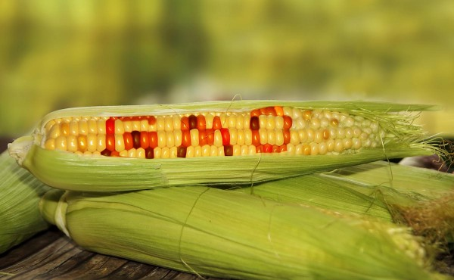
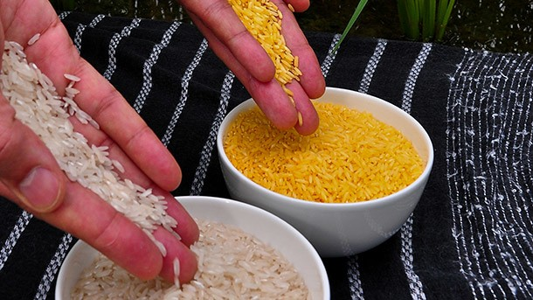
Beyond genetically modified crops

Slide 3
INTRODUCTION
One of the themes running through this book is a consideration of the social context within which genetically modified crops have been developed. Apart from describing the technological development, several chapters have considered the economic forces that have been determined which GM traits were commercialized. This chapter attempts to predict the future trajectory of GM crops by looking not only recent technological developments but also at how these may respond to social and political pressures.

Slide 4
Greener genetic engineering
Although many of the products of plant biotechnology on the market today already offer real environment and health benefits, considerable opposition to GM crops remains. However, new approaches to GM crop production are becoming apparent and might help to make the technology more acceptable.
We have already seen that some of the concerns about GM crops stem from a perception of the potential dangers of inserting foreign genes into plants. One particular concern relates to the use of antibiotic marker genes, and the possibility that the widespread dispersal of such genes may contribute to the development of antibiotic-resistant pathogens.

Slide 5
Genetic manipulation of complex agronomic traits
The removal of undesirable markers genes has been coupled with an increased emphasis on using plant genes in preference to bacterial or animal genes. Gene transfer from widely differing organisms and the creation of publicly perceived `frankenfoods` is avoided, and the emphasis shifts towards modification of plant growth, development, and physiology to bring about the desired changes. This new strategy could bring benefits to the developed and developing world alike. This approach involves identifying plant genes to produce agronomic benefits.

Slide 6
Introduction of Arabidopsis LEAFY gene into rice that accelerates flowering just enough to allow two crops per year, with only a small reduction of yield per year.
Similar approaches have been taken to speed up the reproductive development of citrus trees.

Slide 7
The development of dwarf strains of cereals like wheat and rice led to the green revolution of the 1960s and 1970s, which transformed countries like India into net wheat exporters. Borlaug was awarded the Nobel Prize for peace for his pioneering work in this area. Dwarf strains are generally higher-yielding as less of the photoassimilate goes into growth and more goes into the grain. They Also have the advantage of being less prone to damage from wind and rain.

Slide 8
The pressures to make GM technology more acceptable combined with the scientific opportunities presented by the genomics revolution point the way forward for a new paradigm of crop improvement; molecular breeding.
This describes a set of approaches and technologies that integrate genetic technologies with conventional breeding. To fully appreciate this, it is necessary to consider the nature of the information and technologies that might contribute to this new approach, as follows.

Slide 9
The identification of genes that play a role in determining agronomic traits.
The elucidation of pathways and systems that underpin complex traits.
The ability to transfer multiple genes into crop plants. Many of the complex traits of interest will require modification of several genes.

Slide 10
IDENTIFICATION OF GENES ASSOCIATED WITH DESIRABLE TRAITS
GENETIC MAPPING:
Describes method used to identify the locus of a gene and distance between genes.
Essence of mapping is to place a collection of markers to respective position in genome.
Markers are fragment of DNA that is associated with a certain location in genome
A series of milestones or markers along chromosomes that provide positional information
Most useful concept when dealing with large genomes of crop plants

Slide 11
TYPES OF MARKERS OR MILESSTONES
Markers aregenerally of two types:
Genetic markers
Physical markers

Slide 12
GENETIC MARKERS
Identified by specific phenotypes
Map location is determined by genetic crossings as used by Morgan in 1949 to map position of eye color and wing shape in drosophila.
They are single gene mutations defining two alleles with distinguishable phenotypes

Slide 13
2.PHYSICAL MARKERS:
Identified by molecular biological techniques
These markers can be observed directly rather than via the expression of a phenotype
Like genetic markers they are polymorphic
They are dominant are recessive both alleles can be detected equally

Slide 14
TYPES OF POLYMORPHISM
SNPs:single nucleotide polymorphism
Single base mutation,subtitution (insertion, deletion)
Snps occur throughout the genome at frequency of about 1 in every100 bases estimates to arise mutation at a rate of 10⁻⁹ per nucleotide
Most SNPs occur in higher eukaryotes in non-coding parts of genome and have no effect on genome.

Slide 15
2.SIMPLE SEQUENCE REPEATS
Tandem repeats of short sequence motifs (1-6 bases) that occur throughout the genome
Polymorphism occur much more frequently in them due to slippage during replication and crossing over.
Polymorphism in SSR forms basis of genetic profiling of human DNA for forensic purposes.

Slide 16
Example of snps and ssr
Fig 1 base subtitution and deletion
Fig 2 no of tandem repeats and simple sequence repeats

Slide 17
QUANTITATIVE TRAIT LOCI
QTL is a chromosomal location where there is a considered to be reasonable probability that functionally different alleles segregate and cause significant effects on quantitative trait.
QTL mapping requires a statistical analysis of molecular marker and phenotypic data from a large segregating population to determine those markers where allelic polymorphism correlates with the quantitative trait phenotype.
Primary QTL mapping locates the gene within a chromosome region(QTL supporting interval).

Slide 18
METHODS TO IDENTIFY GENE INVOLVED IN QUANTITATIVE TRAIT
POSITIONAL CLONING: It requires steps to map QTL to a much inner resolution and relate this map position to DNA sequence
One strategy is to cross nearly isogenic lines in which allelic variation occurs in short region of coarse mapped QTL
This is relatively straight forward,when many polymorphic markers are mapped in region this is currently possible for those plants whose genome is already been sequenced.

Slide 19
CONT…
At this stage markers closest to QTL are used to anchor genetic map to physical map, it may then possible to determine gene responsible or QTL effect(QTN quantitative trait nucleotide polymorphism).
It may be necessary to test each predicted coding sequence in region functionally by over expressing or down regulating gene.

Slide 20
2.ASSOCIATION MAPPING
It avoids the requirement for producing nearly isogenic lines
It is done by calculating statistical association between allelic variants at candidate loci within an existing set of genotypes for instance: (breeding lines, cultivated varieties).

Slide 21
Only a relatively small number of genes responsible for QTLs have been identified Several identified genes encode regulatory proteins involved in flowering time.
For example in experiment in which arabidopsis LEAFY and APETELA genes used to manipulate flowering time on basis of molecular-biological information from model organism

Slide 22
Investigating gene function by reverse genetics

Slide 23
Insertional mutagenesis
One of the most investigating gene function is to mutate the gene so that its function is altered or destroyed. This process has been described as reverse genetics.

Slide 24
Reverse genetics

Slide 25
The absence of a facile system for homologous recombination means that site specific mutagenesis is not possible in plants. However there are other ways of introducing mutations, the most simple involving the introduction of a piece of foreign DNA into the gene.

Slide 26
Methods
Two different methods have been used for this
T-DNA insertion by Agrobacterium-mediated transformation
Transposon-induced mutagenesis

Slide 27
The segment of the Ti plasmid of Agrobacterium tumefaciens known as T-DNA that carries genes to transform the plant cell has also been utilized for insertional mutagenesis. T-DNA insertional mutagenesis has been used to obtain gene knockouts.

Slide 28
Transposons are mobile genetic elements that can relocate from one genomic location to another. They are DNA sequences that can insert themselves at a new location in the genome without having any sequence relationship with the target locus.

Slide 29
Transposon-based signature-tagged mutagenesis has been successful in identifying essential genes as well as genes involved in infectivity of a variety of pathogens. Strategies for insertional mutagenesis using transposons have been developed for a number of animal and plant models.

Slide 30
Advantage
Advantage of this type of insertional mutagenesis is that it is relatively straightforward to locate the point of insertion, as mutagen itself acts as a sequence tag.

Slide 31
Limitations
Complete loss of function
Knockout mutations

Slide 32
TILLING
Targeted induced local lesions in genomes.
Mutation detection tool that offer to study the gene function at fundamental level
Genetically modify crop plants in a specific, targeted fashion without using GM technology.

Slide 34
UNDERSTANDING THE GENE FUNCTION WITHIN THE GENOMIC CONTEXT: FUNCTIONAL GENOMICS
Functional genomics provide a powerful tool to discover the multiple genes involved in complex trait and to understand their regulation and interaction within the plant.
In addition to their reverse genetic tools functional genomics is informed by several other important technologies.

Slide 35
transcriptomics
Transcriptomics encompasses a number of technologies developed to enable the genome wide analysis of gene-expression patterns at the level of mrna population :transcriptome.
These are high throughput technologies designed to measure global changes in gene-expression profile in different tissue or in response to different condition or treatment.

Slide 36
Cont…
Thus this technology is the most powerful tool for gene discovery.
Howevere it has wider application in the development of gm crops .
For example,for analysing the effect of genetic modification upon the regulation of other gene in the genome.

Slide 37
There are now extensive transcriptomics resources available for rearchers ,from centralized microarray facilities that will analyse rna samples to the wide range of expression data stored in various online data bases

Slide 38
INERTACTOMICS
One of the most recent technologies aimed to study the interactions between protiens: the interactomics.
Technologies involved the two hybrid assays and protien microarrays to determine protien-protien interactions.

Slide 39
The interactome is displayed as a network of interactions,in which certain protiens form nodes with connection to many other protiens ,others are more peripheral with one or a few partners.

Slide 40
Proteomics
The nature of transcriptomics lends itself to high-throughput technologies (since mRNA differ only by nucleic acid sequence), the platforms available for proteomics are more limited in capacity to analyze entire proteomics. The important thing about proteomics is that the transcriptome is often used as shorthand for gene expression of a sample. It is true for many proteins that mRNA level is a good indicator of protein expression.
In plant cell proteome, extensive characterization of the proteins found in different subcellular compartments, including the nucleus, chloroplast, mitochondria, plasma membrane and cell wall

Slide 41
Metabolomics
Metabolomics is the scientific study of chemical process involving metabolites, the small molecule intermediates and products of metabolism.
One of the important finding about metabolic investigation is that genetic engineering is a precise science with fewer differences in metabolite concentrations between a transformed plant and control plant between different varieties of same plant.

Slide 42
System biology
System biology attempts to integrate the information from different strands of functional genomics. One of the major problems facing genomic scientists is not only how to store or annotate this data in a reliable and accessible form, but also how to integrate the finding of disparate experiments.

Slide 43
Summary
This chapter attempted to predict the future direction of plant biotechnology applied to crop improvement. Our knowledge of plant biology is accelerating as new genomic tools are applied and these tools are enabling the discovery of genes that play important role in agronomic traits, and it is really unavoidable that this knowledge will be used in crop improvement.

Slide 44
THANK YOU

